Slide 1
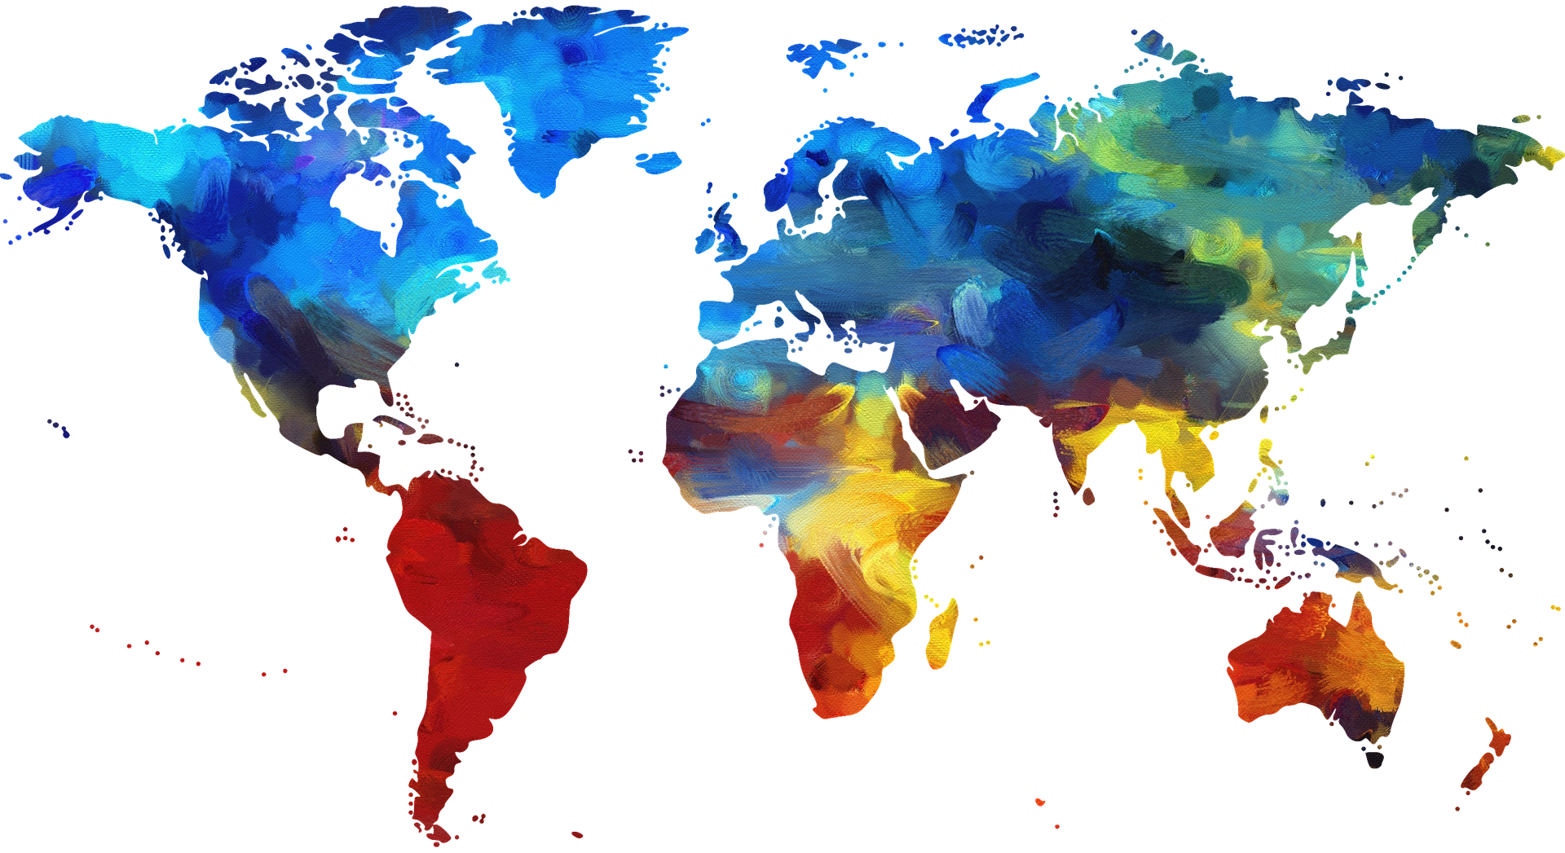
WELCOME BIENVENUE
Lesson 2: Greetings

Slide 2
Lesson Objectives
I can:
Make observations about differences in culture.
Say hello in English.

Slide 3
Objectifs de la leçon
Je peux:
Faire des observations sur les différences de culture.
Dire bonjour en anglais.

Slide 4
Culture
GREETINGS & INTRODUCTIONS

Slide 5
Cultures Collide

Slide 6
CULTURE Different is different

Slide 7
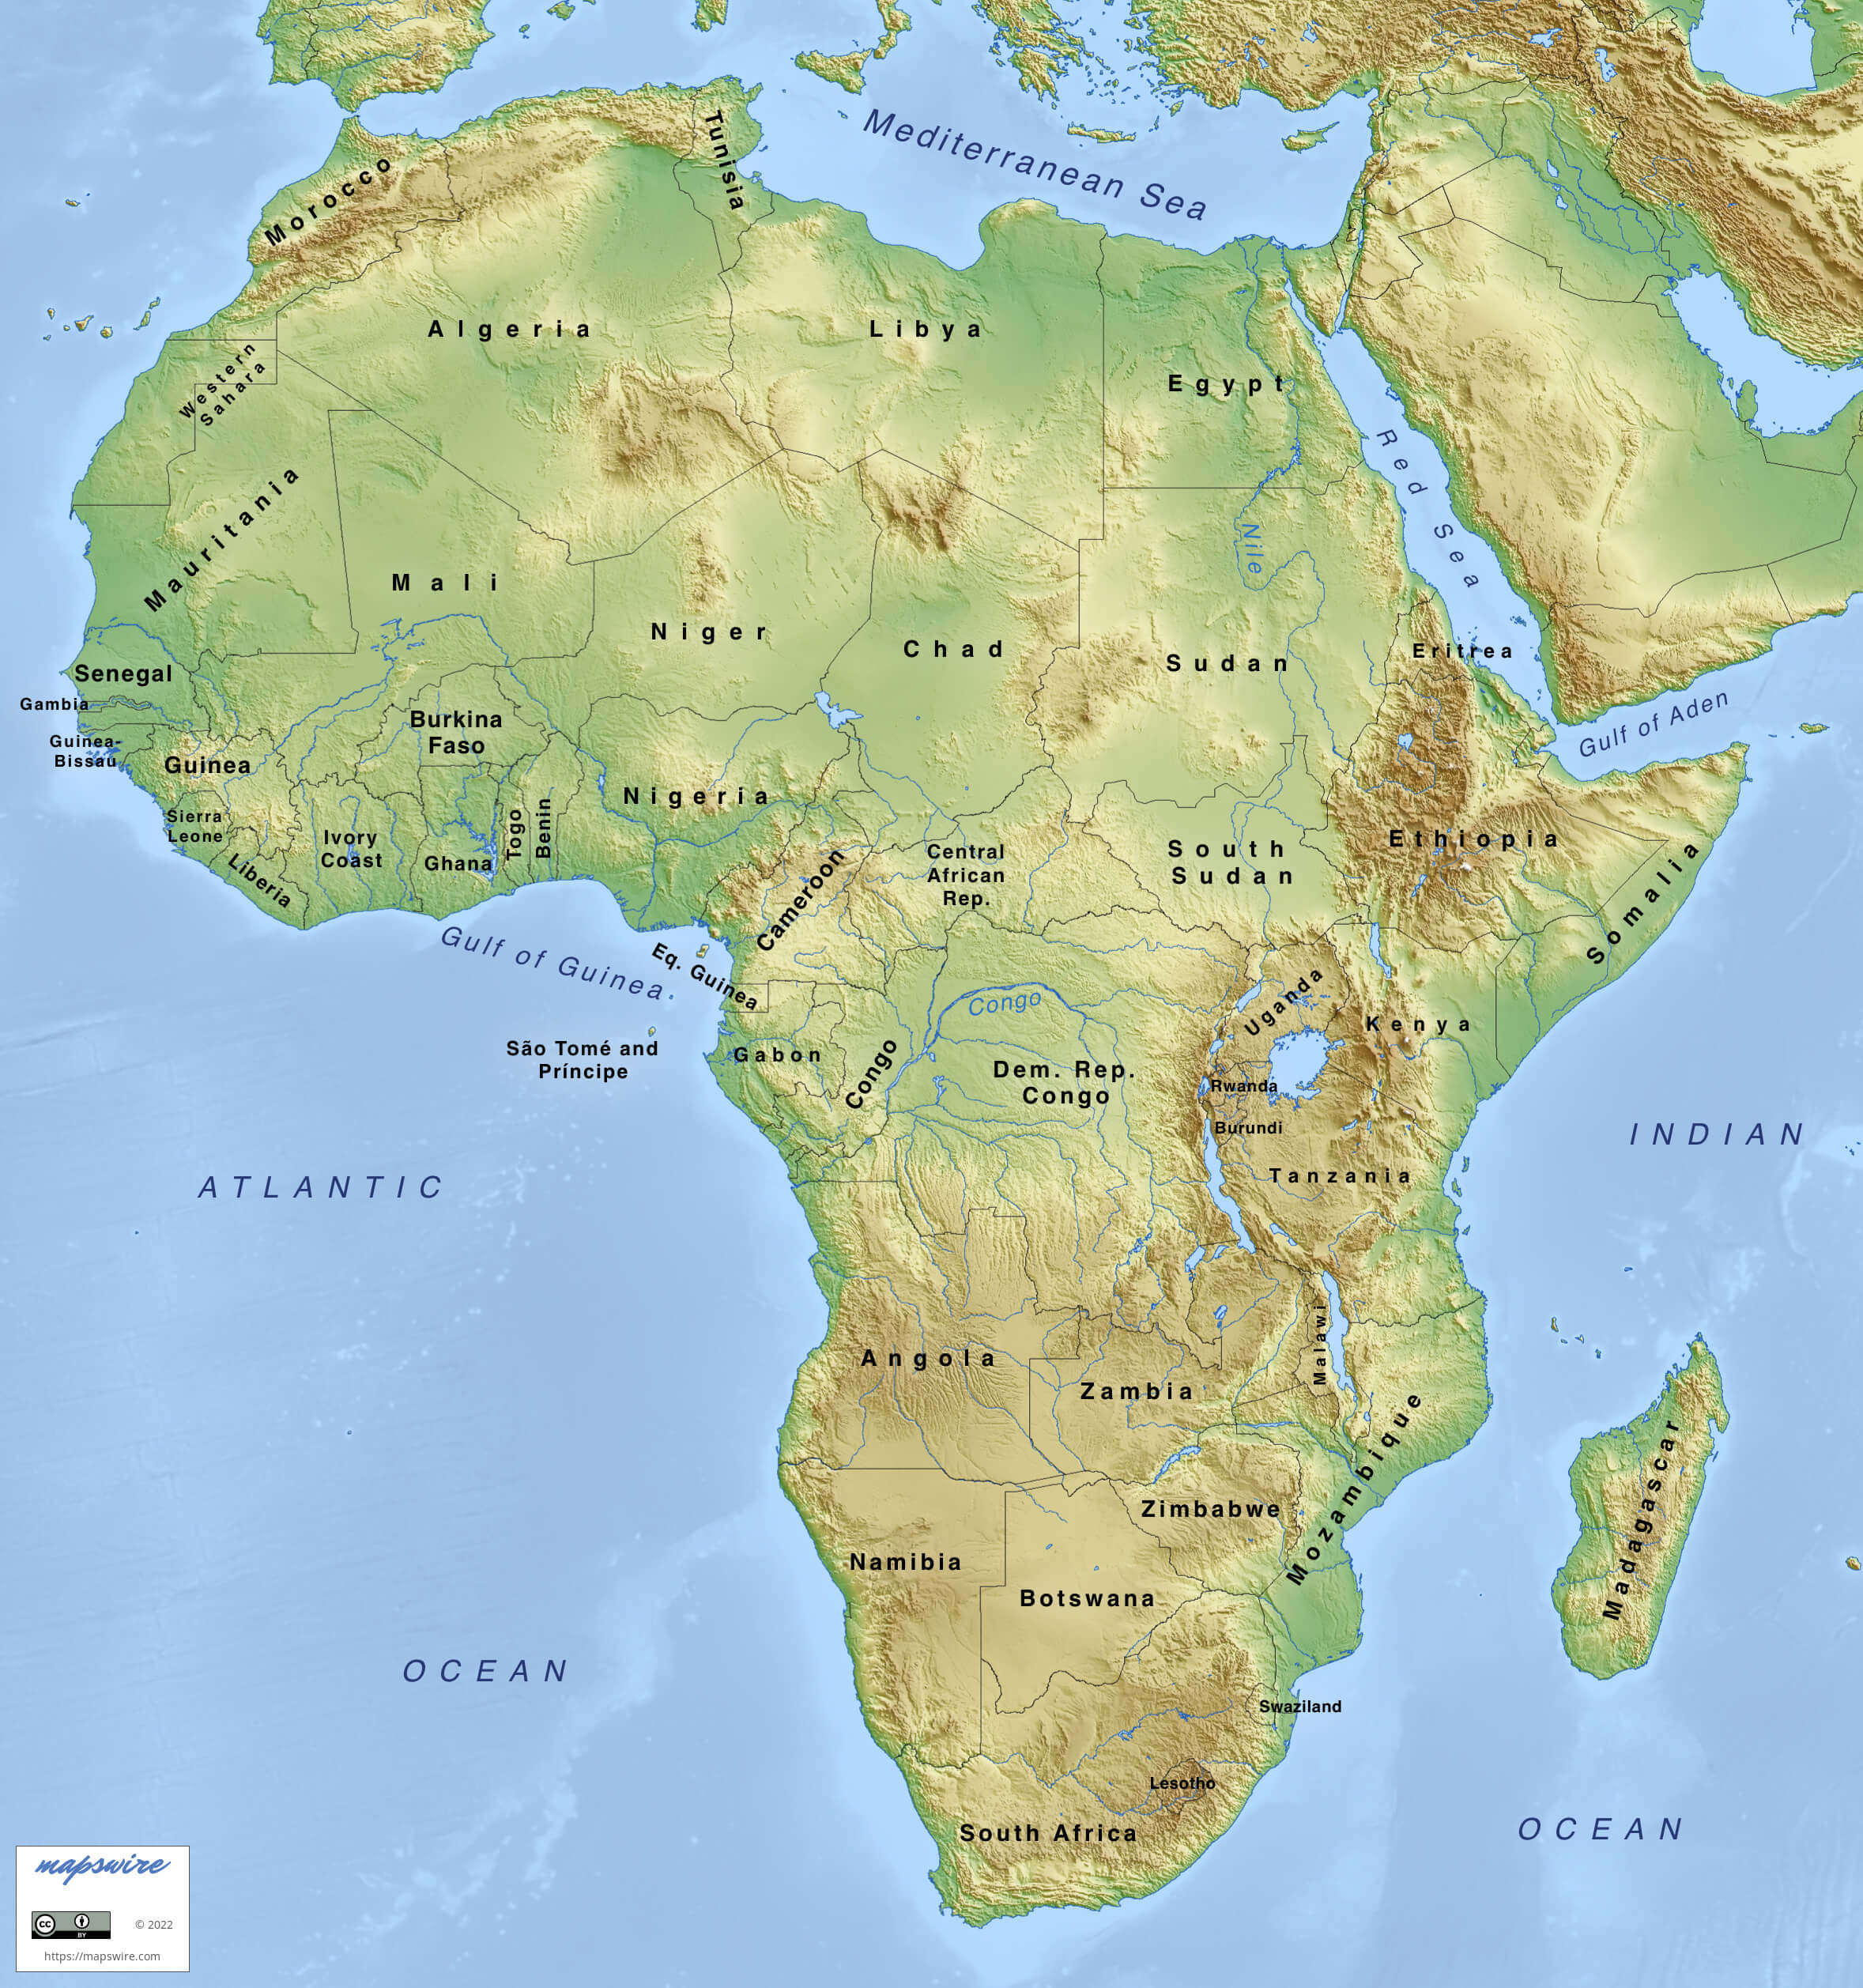
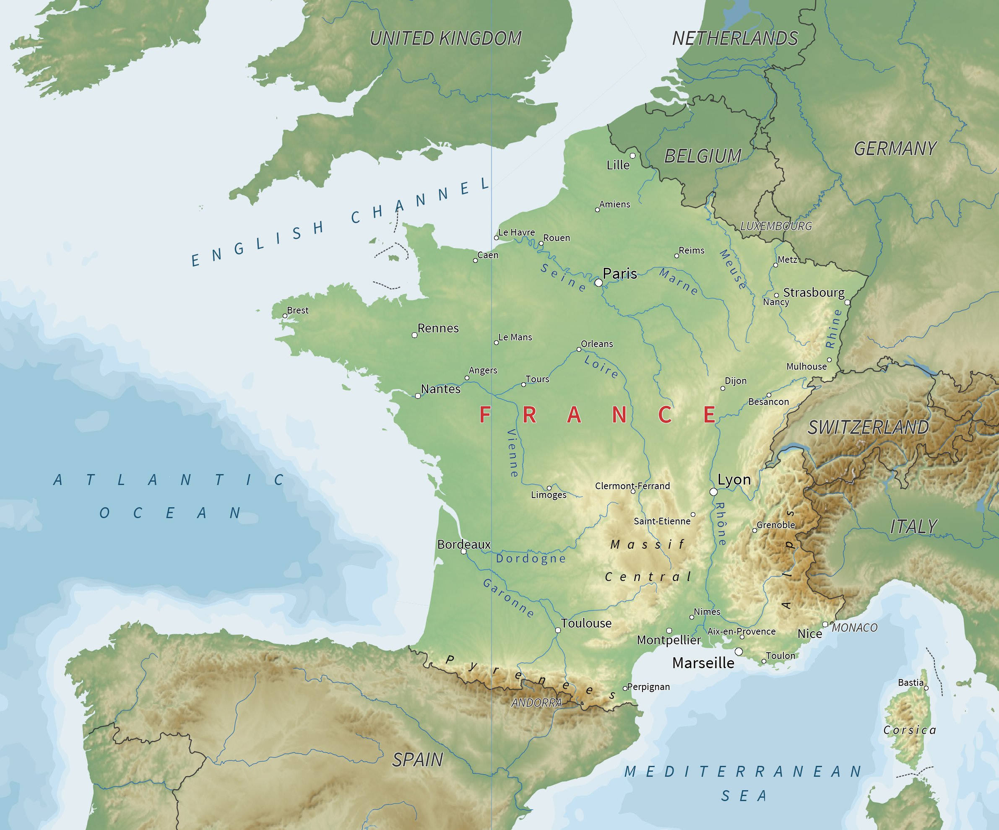
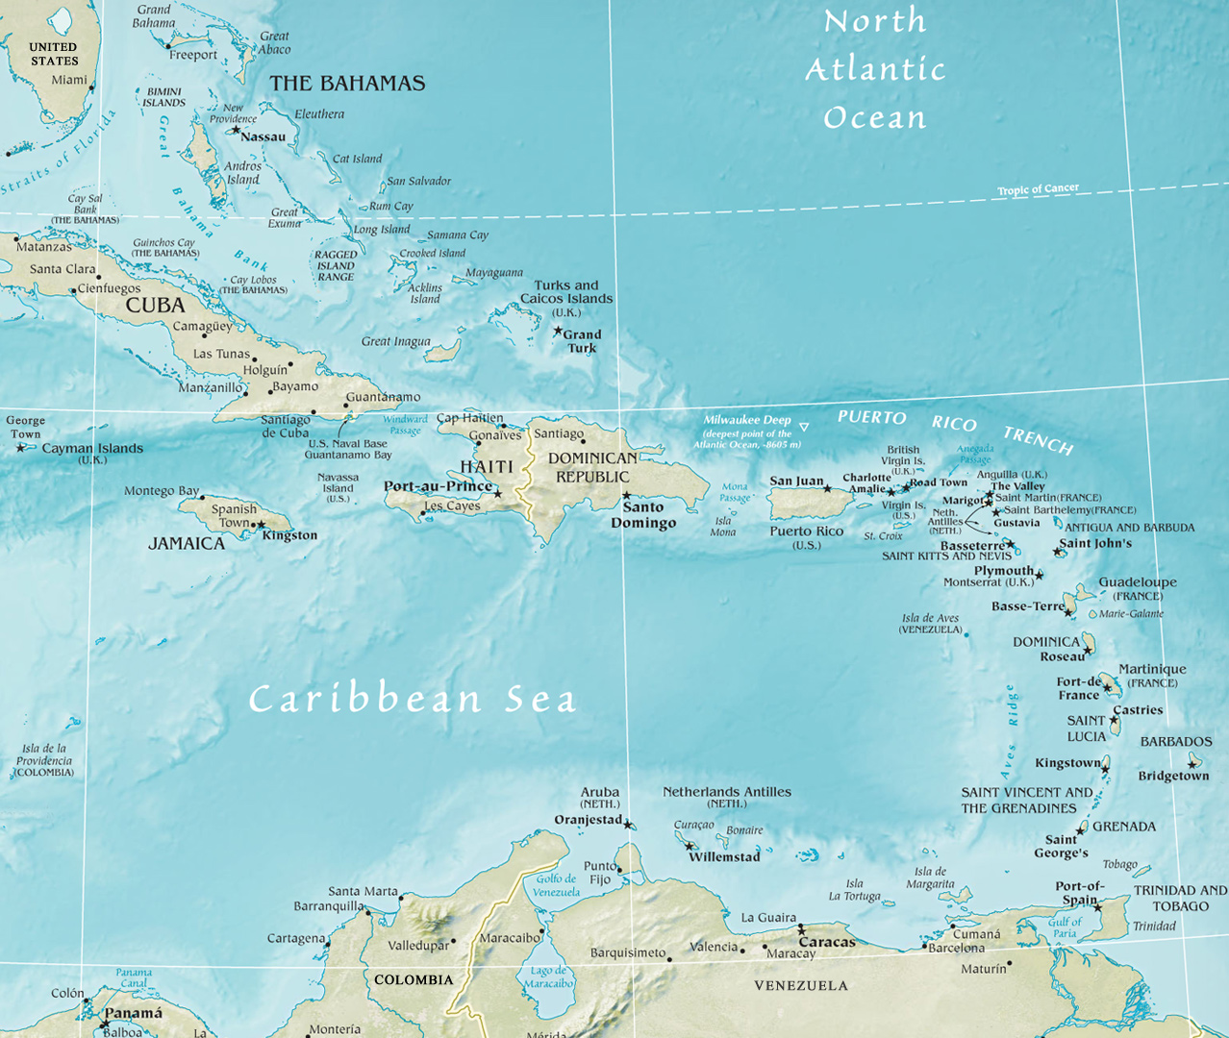
Haiti’s Cultural Influences
Africa, France, Caribbean

Slide 8
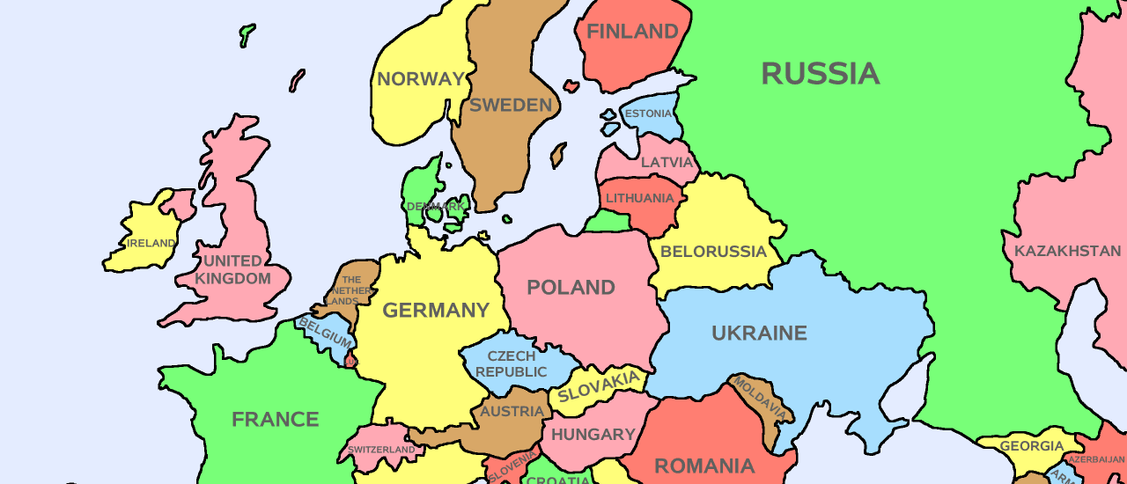
United States Cultural Influences
Northern Europe

Slide 9
Like the Weather Warm vs. Cold

Slide 10
Saying Hello
GREETINGS & INTRODUCTIONS

Slide 11
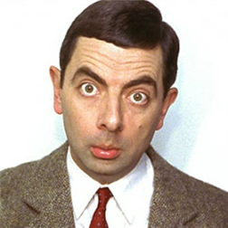
An American Saying Un proverbe américain
You never get a second chance to make a first impression.
Vous n'aurez jamais une deuxième chance de faire une première impression.
What do you think?
Qu'en penses-tu?

Slide 12
Basic American Introductions

Slide 13
Basic American Greetings

Slide 14
How To Greet Americans

Slide 15
Hello, Goodbye

Slide 16
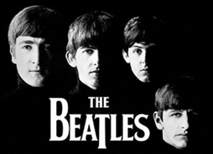
Hello, Goodbye The Beatles
You say yes, I say no
You say stop and I say go go go, oh no
You say goodbye and I say hello
Hello hello
I don't know why you say goodbye, I say hello
Hello hello
I don't know why you say goodbye, I say hello
I say high, you say low
You say why and I say I don't know, oh no
You say goodbye and I say hello
(Hello goodbye hello goodbye) Hello hello
(Hello goodbye) I don't know why you say goodbye, I say hello
(Hello goodbye hello goodbye) Hello hello
(Hello goodbye) I don't know why you say goodbye
(Hello goodbye) I say hello/goodbye

Slide 17
Hello, Goodbye The Beatles
Why why why why why why do you say goodbye goodbye, oh no?
You say goodbye and I say hello
Hello hello
I don't know why you say goodbye, I say hello
Hello hello
I don't know why you say goodbye, I say hello
You say yes (I say yes) I say no (But I may mean no)
You say stop (I can stay) and I say go go go (Till it's time to go), oh
Oh no
You say goodbye and I say hello
Hello hello
I don't know why you say goodbye, I say hello
Hello hello
I don't know why you say goodbye, I say hello
Hello hello
I don't know why you say goodbye, I say hello hello

